Slide 1
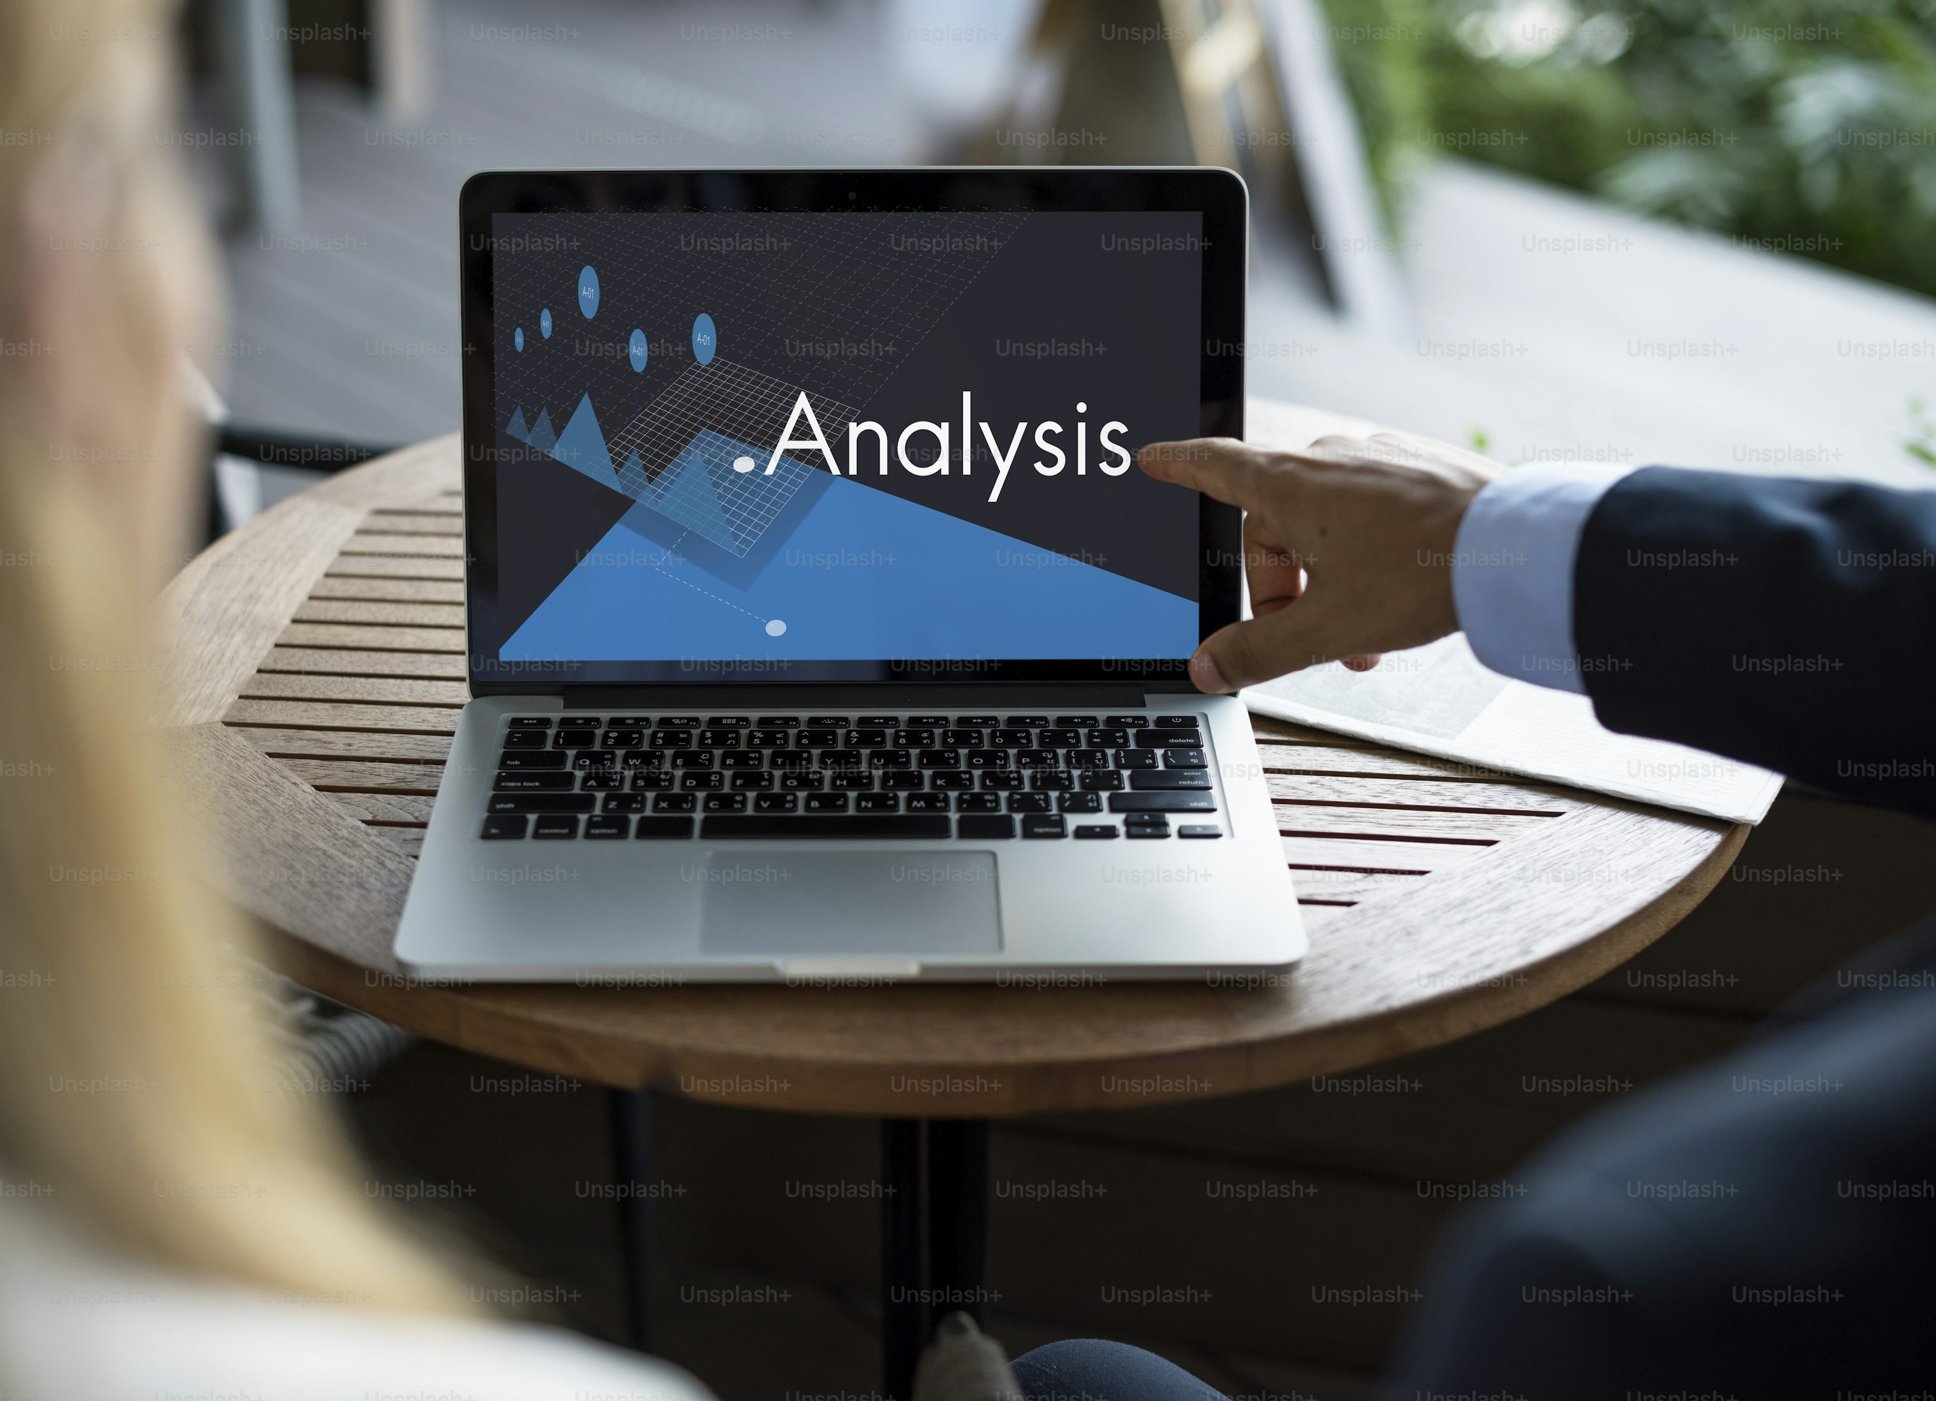
Case Study on Customer Behavior for Online Food Delivery by Sachin Gunjal
A Real-Life Data Analyst Case Study

Slide 2

WHAT WILL WE DISCUSS
INTRODUCTION
OBJECTIVES
ACHIEVABLE RESULTS
METHODOLOGIES
APPROACHES
KEY FINDINGS
ACTIONABLE
INSIGHTS
CONCLUSIONS

Slide 3
INTRODUCTION
What the Project is About: This case study focuses on analyzing customer behavior for an online food ordering platform using SQL. The goal is to use raw data from a database to understand customer preferences, product performance, and the effectiveness of the loyalty program.
This case study explores customer behavior using SQL-based database analysis for an online food delivery platform.
The dataset includes 5 key tables: Sales, Product, Users, Username, and Goldusers_Signup.
Goal: To understand purchasing patterns, product popularity, and gold membership value.

Slide 4

OBJECTIVES
Understand Customer Spending Patterns: Determine how much customers are spending and what products they prefer.
Track Membership Behavior: Identify how many users became gold members and how their behavior changed before and after joining.
Identify Top Products: Recognize the best-selling and most profitable menu items
Measure Engagement and Loyalty: Analyze how frequently customers order and how long gold members stay active.

Slide 5

ACHIEVABLE RESULTS
7. Employee Career Pathing and Domain Switching
Revenue Insights: Calculate total revenue per product and year using SQL aggregation.
Membership Impact: Compare revenue and activity between gold members and non-members.
Customer Segmentation: Identify customers with high spending and regular purchases, useful for loyalty targeting.
Product Trends: Found top 3 products with the highest sales, and the first purchase after gold signup.

Slide 6
METHODOLOGY
SQL for data analysis: Used Microsoft SQL Server to run queries on five related tables.
Join operations: Linked tables (e.g., User_name with Sales) using user IDs.
Aggregations: Used SUM(), COUNT(), GROUP BY, etc., to summarize data.
Time-based filtering: Checked signup dates, gold membership dates, and sale dates.
Window functions: Used ROW_NUMBER() and RANK() to track order history and sequence.

Slide 7

METHODOLOGY
TOOLS AND TECH
SQL / MS SQL Server
Data cleaning & aggregation queries
Joins, subqueries, CASE statements, and update queries

Slide 8
APPROACHES
Segmented gold vs. regular users: Compared their orders, spending, and engagement.
Pre vs. Post gold membership analysis: Studied if behavior changed after joining.
Top products by segment: Identified what gold members buy most.
Customer order timeline: Tracked when each customer joined, ordered, and upgraded.
Frequency analysis: Measured how often users order, which shows loyalty.

Slide 9
KEY FINDINGS
Table Wise analysis points with proper numerical and dimension data

Slide 10
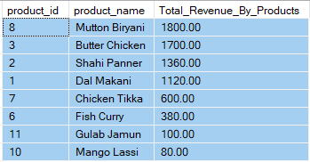
TOTAL SALES REVENUE GENERATED BY EACH PRODUCT
KEY FINDINGS
Top Product:
1. Mutton Biryani 2. Butter Chicken 3. Shahi Paneer

Slide 11
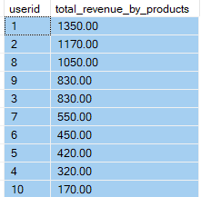
TOTAL REVENUE GENERATED FROM GOLD USERS Total Revenue : $7140
KEY FINDINGS

Slide 12
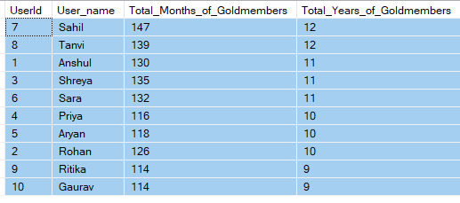
HOW MUCH OF TIME USERS HAS BEEN A GOLD USER
KEY FINDINGS

Slide 13
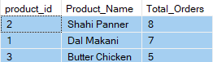
THE MOST POPULAR PRODUCT AMONG GOLD USERS
KEY FINDINGS
Shahi Panner
Dal Makani
Butter Chicken

Slide 14
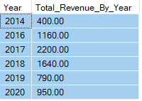
TOTAL SALES REVENUE GENERATED IN EACH YEAR
KEY FINDINGS

Slide 15
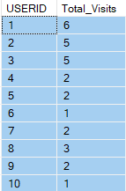
THE FREQUENCY OF CUSTOMER VISITS TO THE ONLINE PLATFORM
KEY FINDINGS

Slide 16
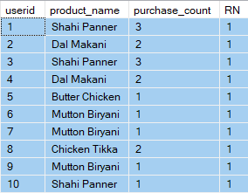
MOST POPULAR FOR EACH CUSTOMER
KEY FINDINGS

Slide 17
INSIGHTS
Top Revenue
Most Popular Product Name
Year of highest Revenue
2017
High Revenue by Product
$7140
Shahi Paneer
Mutton Biryani

Slide 18
INSIGHTS (Deeper Understanding Gained)
Gold members are more valuable, both in terms of spend and loyalty.
Customers tend to change their preferences over time; first orders don’t always reflect long-term favorites.
Mid-priced items often sell better than expensive or cheap ones.
Purchase patterns reveal behavioral triggers—e.g., someone bought multiple times just before becoming a member.
Data shows actual behavior, which is more reliable than assumptions or intuition

Slide 19
ACTIONABLE
 | Actions that can be Taken
1. Promote Top 3 Revenue-Generating Products | Feature these dishes in homepage banners, combo meals, and discounts to increase their sales even more.
2. Boost Gold Membership Signups | Offer exclusive benefits like free delivery, early access to new items, or discounts to non-gold users to increase conversions.
3. Use Product Triggers to Drive Membership | Identify these “trigger items” and advertise them with messages like “Buy now and unlock gold perks”
4. Personalize Offers Based on First and Favorite Orders | Send personalized offers like “Your favorite Butter Chicken is 15% off” or “Try something new like your first order again”
5. Reward Loyal, High-Spending Customers | Offer loyalty rewards like surprise coupons, early access menus, or thank-you credits to retain top spenders.
6. Promote High-Converting Menu Items to New Users | Offer these items to new or undecided users as part of welcome offers to encourage their first order or gold signup.
7. Launch Visit-Based Rewards to Increase Engagement | Introduce challenges like “Order 3 times this month and get ₹50 off” to drive repeat platform visits and boost orders.

Slide 20
CONCLUSIONS
This case study proves that SQL is a powerful tool for analyzing customer behavior.
By exploring five related datasets, we could:
Measure loyalty program impact,
Identify revenue drivers,
Personalize the customer experience,
And support data-driven business decisions.

Slide 21

THANK YOU
SACHIN GUNJAL
sachingunjalmain@gmail.com
Sachin Gunjal | LinkedIn

